Slide 1
DriveMzansi
Pick it. Book it. Drive it.
One platform to run car rentals, from booking to payment.
Database Systems Group Project

Slide 2
Running rentals shouldn’t mean juggling spreadsheets
Scattered records
Double-booking
Blind spots
Customer, vehicle and booking details end up in separate places, with separate versions.
A car can be booked twice for the same dates, because nothing checks availability.
No single view of availability, booking status or revenue.

Slide 3
One platform. Three promises.
Pick
Book
Drive
Browse the fleet by category, with a daily rate for each vehicle and its current status.
Reserve a car for any start and end date, then track the booking from pending to completed.
See what is available, booked or cancelled, and where revenue comes from, right now.

Slide 4
Everything your rental desk needs
Login & dashboard
Vehicle management
Customers
Secure sign-in and a home screen with live statistics and graphs.
Add, update and track every car, its category and status.
One record per customer, including the licence needed to rent.
Bookings
Payments
Reports
Create bookings with start and end dates and track each booking’s status.
Cash, Card, EFT or Mobile Money, tied to a booking.
Availability, booking history and revenue, filtered and ready to use.

Slide 5
The right access for every user
Admin
Staff
Customer
Runs the system: vehicles, customers, user roles and table structure, plus reports across the business.
Works the rental desk: registers customers, processes bookings and records payments.
Signs in to see their own details and rental activity, linked to their customer record.
Passwords are stored as hashes, never in plain text.

Slide 6
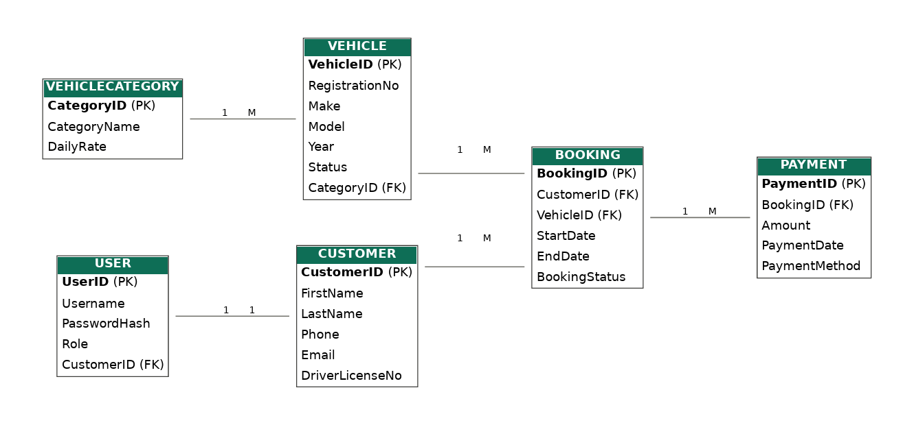
Built on a clean, connected data model

Slide 7
UNF to 1NF: one table per entity
UNF
All 29 attributes in one flat list
Customer
CustomerID
CustomerFirstName
CustomerLastName
CustomerPhone
CustomerEmail
DriverLicenseNo
User
UserID
Username
PasswordHash
Role
Category
CategoryID
CategoryName
DailyRate
CustomerID
CustomerFirstName
CustomerLastName
CustomerPhone
CustomerEmail
DriverLicenseNo
CategoryID
CategoryName
DailyRate
VehicleID
RegistrationNo
Make
Model
Year
VehicleStatus
VehicleSalePrice
UserID
Username
PasswordHash
Role
PaymentID
Amount
PaymentDate
PaymentMethod
BookingID
StartDate
EndDate
ActualReturnDate
BookingStatus
Vehicle
VehicleID
RegistrationNo
Make
Model
Year
VehicleStatus
VehicleSalePrice
Booking
BookingID
StartDate
EndDate
ActualReturnDate
BookingStatus
Payment
PaymentID
Amount
PaymentDate
PaymentMethod

Slide 8
2NF and 3NF: linked by foreign keys
2NF
Every attribute depends on its whole key. Foreign keys (*) connect the tables
3NF
No indirect dependencies, so the tables stay as they are
Customer
CustomerID
CustomerFirstName
CustomerLastName
CustomerPhone
CustomerEmail
DriverLicenseNo
User
UserID
Username
PasswordHash
Role
CustomerID *
Category
CategoryID
CategoryName
DailyRate
Vehicle
VehicleID
RegistrationNo
Make
Model
Year
VehicleStatus
VehicleSalePrice
CategoryID *
Booking
BookingID
StartDate
EndDate
ActualReturnDate
BookingStatus
CustomerID *
VehicleID *
Payment
PaymentID
Amount
PaymentDate
BookingID *

Slide 9
Designed for accuracy: normalized to 3NF
6
5
3NF
3
tables
relationships
no repeated data
user roles
One vehicle, one category
Every payment accounted for
Every vehicle belongs to one category, which sets its daily rate.
Each payment is tied to a single booking.
Clear booking status
No duplicates
Pending, confirmed, completed or cancelled, so nothing is ambiguous.
Registrations, licences and usernames are unique.

Slide 10
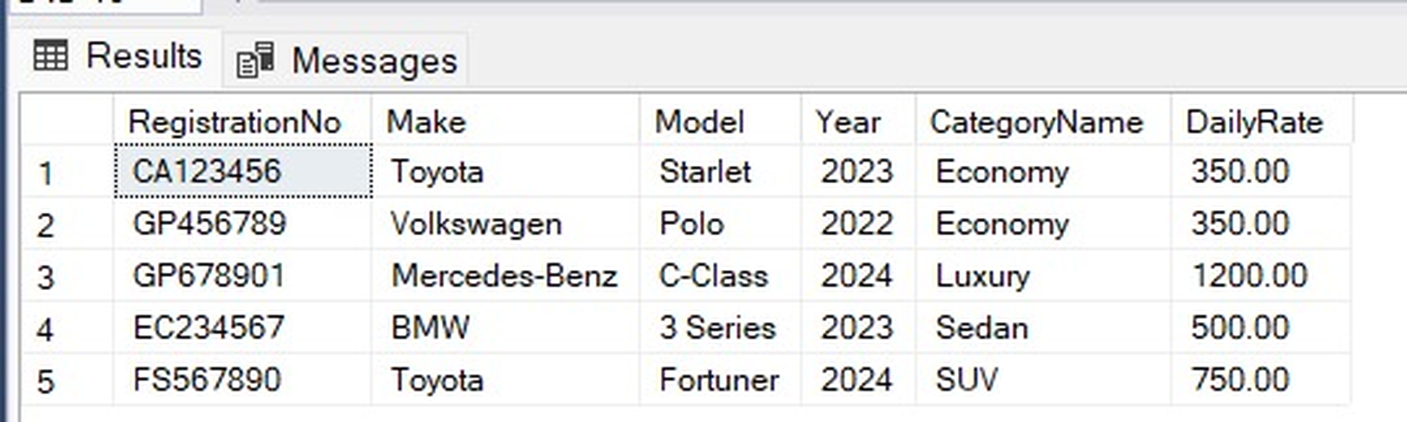
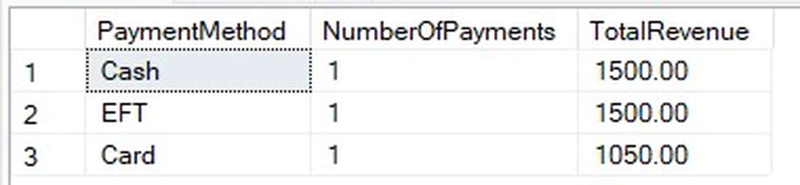
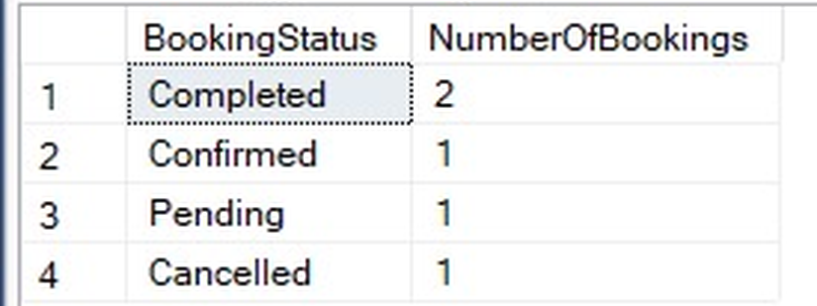
Answers in a single query
Available vehicles
Revenue by payment method
Bookings by status
What can be rented right now.
Where the money is coming from.
Completed, confirmed, pending, cancelled.
Plus customer booking history, payment trends and per-customer booking counts.

Slide 11
Pick it. Book it. Drive it.
DriveMzansi: one system for every rental on the road.
Built with Python and MySQL
Thank you

